Slide 1
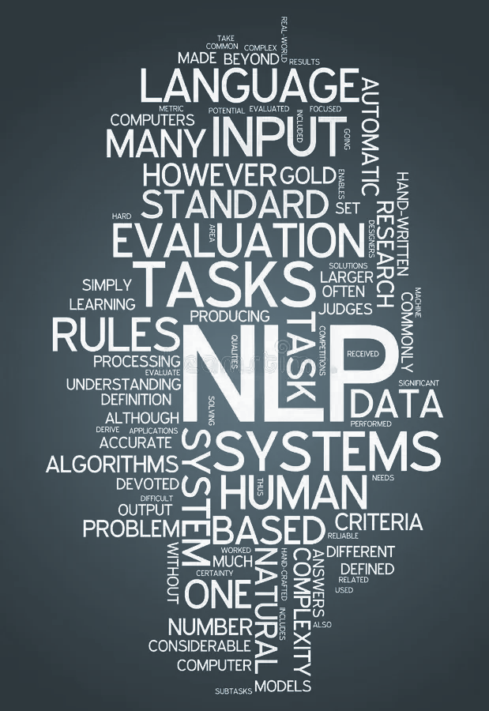

Introduction to ML, DL Supervised and Unsupervised in text analytic
Muhajir Akbar Hasibuan
Class Meeting 4
2023

Slide 2

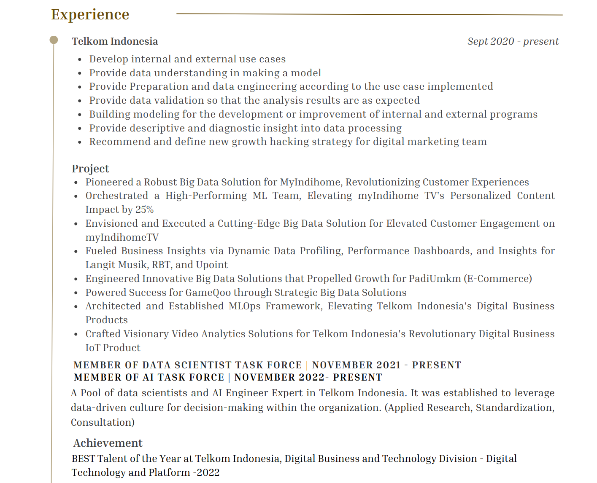

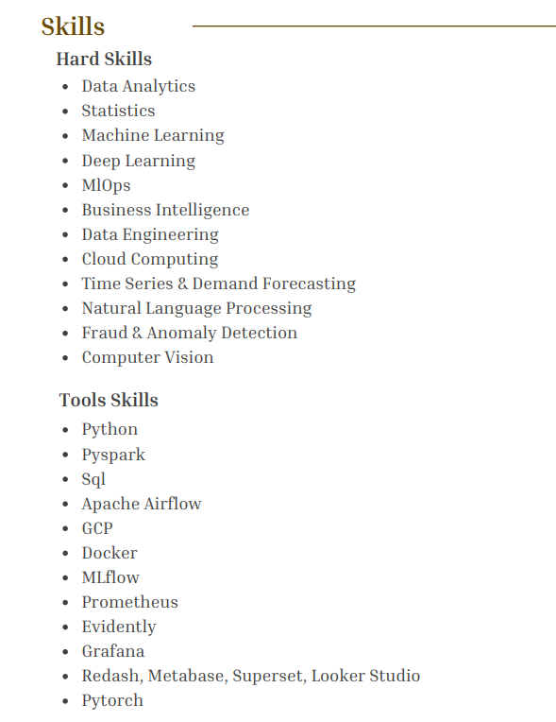

Slide 3
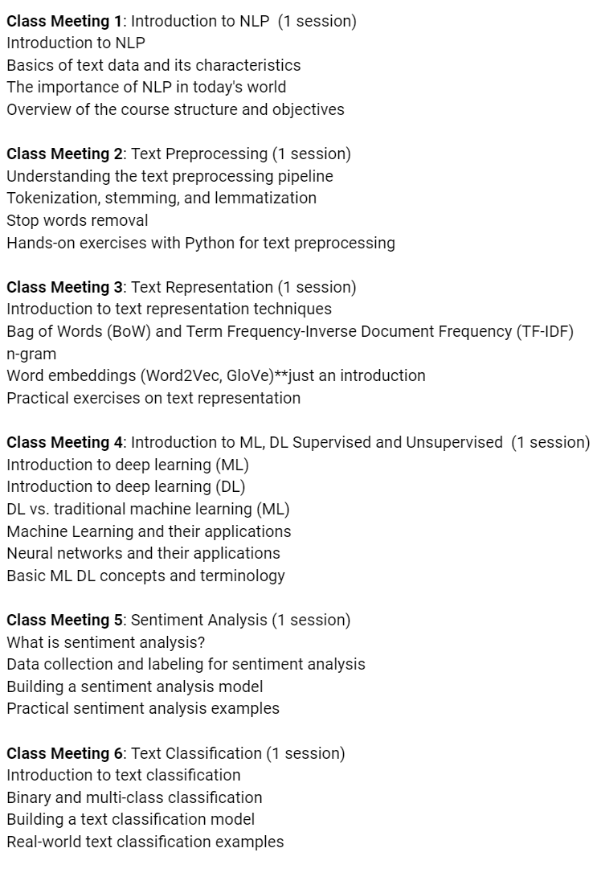
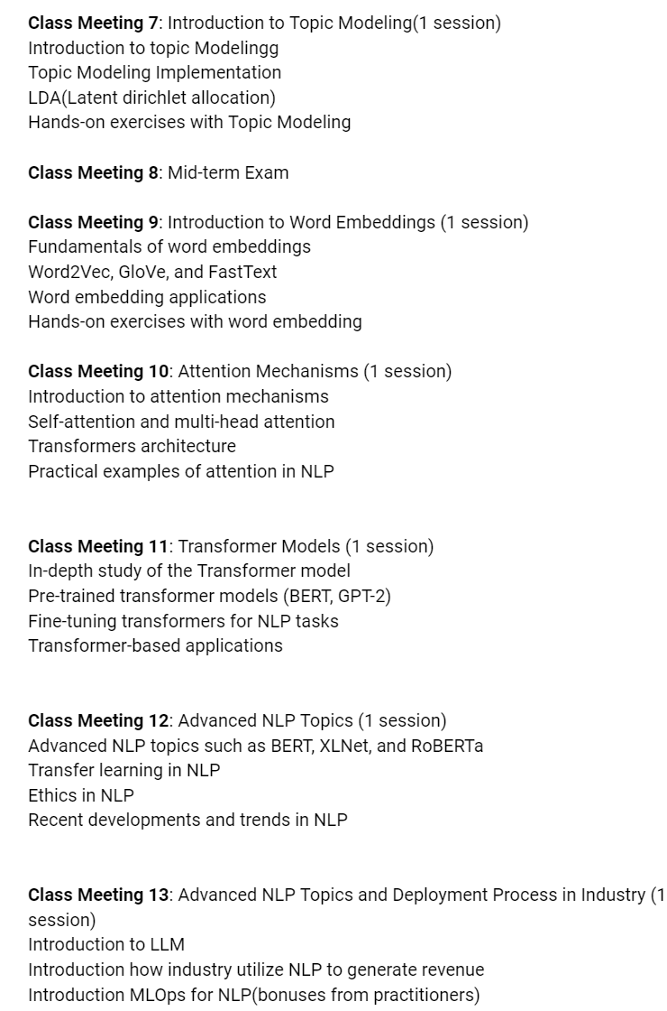

6
mid term
Sesi Khusus deep Learning

Slide 4
Agenda
Supervised vs Unsupervised
Basic ML and DL Concepts in NLP
Machine Learning Applications in NLP
Neural Networks in NLP

Slide 5
Supervised vs Unsupervised

Slide 6
Supervised vs Unsupervised
In natural language processing (NLP), supervised learning involves training models on labeled data, where each input is associated with a known outcome or category, enabling the model to make predictions or classifications based on these examples. In contrast, unsupervised learning in NLP seeks to uncover hidden patterns and structures within unannotated or unlabeled text data, often for tasks like clustering, topic modeling, or word embeddings, without the guidance of predefined categories or labels.

Slide 7
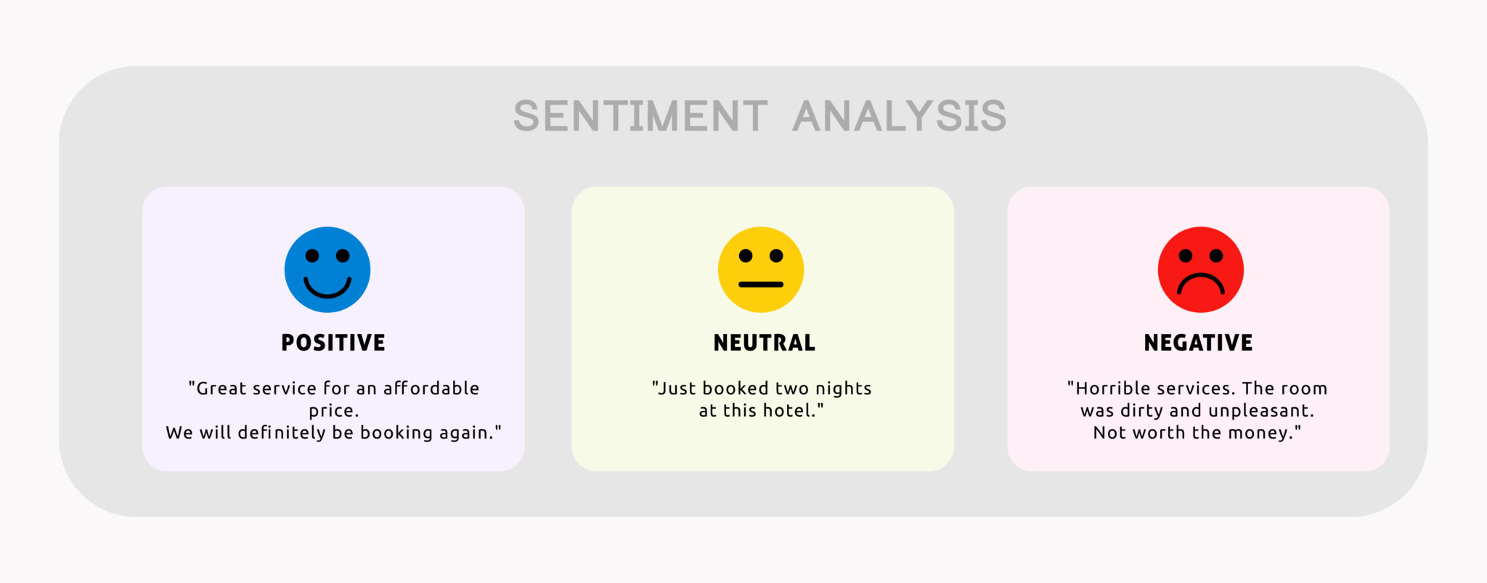
Supervised or Unsupervised?

Slide 8

Supervised or Unsupervised?

Slide 9
Machine Learning vs Deep Learning

Slide 10
ML vs DL
The main difference between machine learning (ML) and deep learning (DL) in natural language processing (NLP) lies in the complexity of their models: while ML methods often rely on manually engineered features and may struggle with capturing intricate linguistic nuances, DL techniques, such as neural networks, excel at automatically learning hierarchical representations from data, making them exceptionally effective for tasks like sentiment analysis and machine translation.

Slide 11
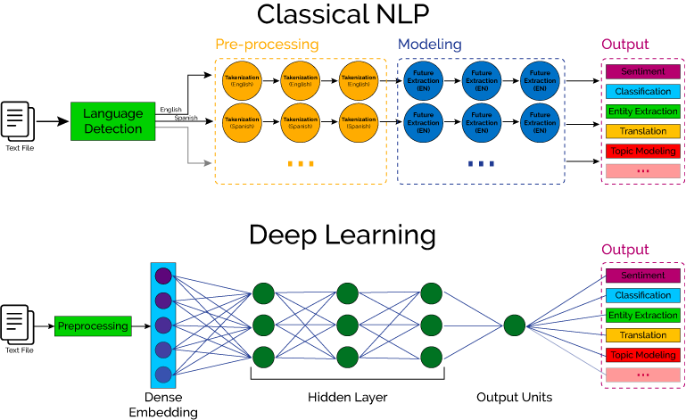
ML vs DL

Slide 12
Supervised Learning in NLP

Slide 13
Supervised
In natural language processing (NLP), supervised learning is a powerful technique where machine learning models are trained on labeled datasets, allowing them to learn the relationships between input text and specific linguistic attributes or classifications, such as sentiment analysis, part-of-speech tagging, or named entity recognition.

Slide 14
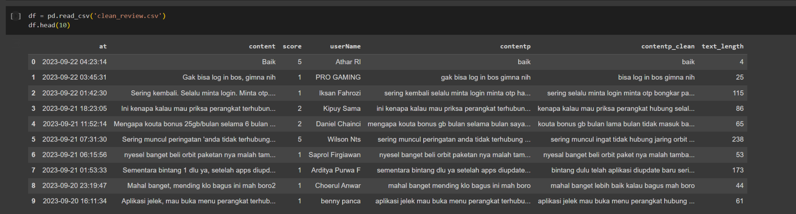
Supervised - Machine Learning
In the field of natural language processing (NLP), supervised learning, a fundamental branch of machine learning, plays a crucial role as it enables NLP models to be trained on labeled datasets, thereby teaching them to make predictions, classifications, and linguistic analyses based on annotated text data

Slide 15
Supervised - Machine Learning
Label
Whats Next?

Slide 16
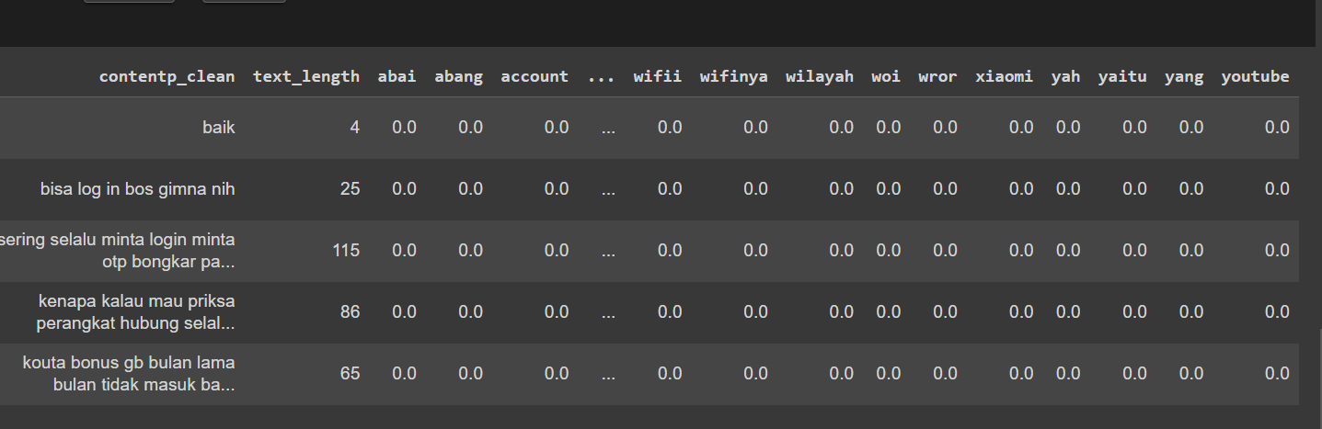
Supervised - Machine Learning
One of the most common techniques for text classification tasks, such as spam detection or sentiment analysis, involves using TF-IDF (Term Frequency-Inverse Document Frequency) to weigh and represent words in a document, allowing for effective feature extraction and subsequent classification
Label

Slide 17
Supervised - Deep Learning
In natural language processing (NLP), supervised learning with deep learning techniques involves training neural networks on labeled text data, enabling them to automatically learn complex patterns and relationships within the language, which is instrumental for tasks like machine translation, sentiment analysis, and named entity recognition

Slide 18
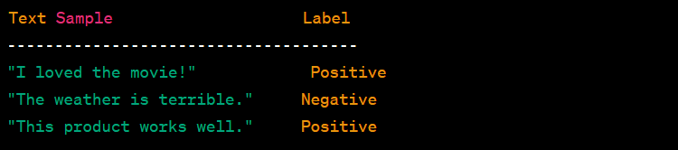
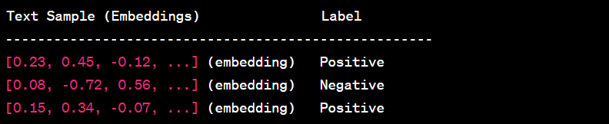
Supervised - Deep Learning
In natural language processing (NLP), supervised learning with deep learning techniques involves training neural networks on labeled text data, enabling them to automatically learn complex patterns and relationships within the language, which is instrumental for tasks like machine translation, sentiment analysis, and named entity recognition

Slide 19
Supervised - Deep Learning

Slide 20
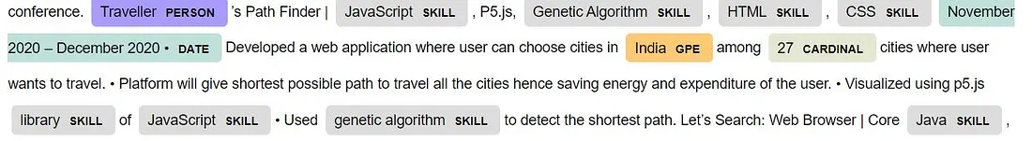
Deep Learning (NER)
Named Entity Recognition (NER) leverages the power of deep learning, often employing neural network architectures like BiLSTM-CRF and Transformer-based models, to accurately identify and categorize entities such as names of people, organizations, and locations within unstructured text, making it an essential tool for information extraction in natural language processing

Slide 21
Unsupervised Learning in NLP

Slide 22
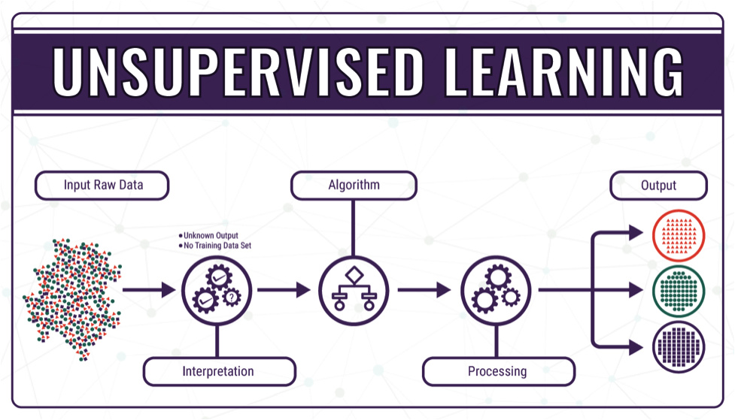
Unsupervised NLP
Unsupervised learning in natural language processing (NLP) involves the exploration of large text corpora to discover hidden patterns, structures, or clusters within unannotated data, enabling tasks such as topic modeling, document summarization, and word embedding creation without the need for labeled training examples.

Slide 23
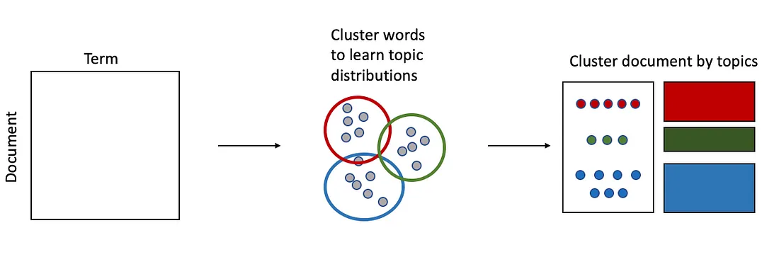
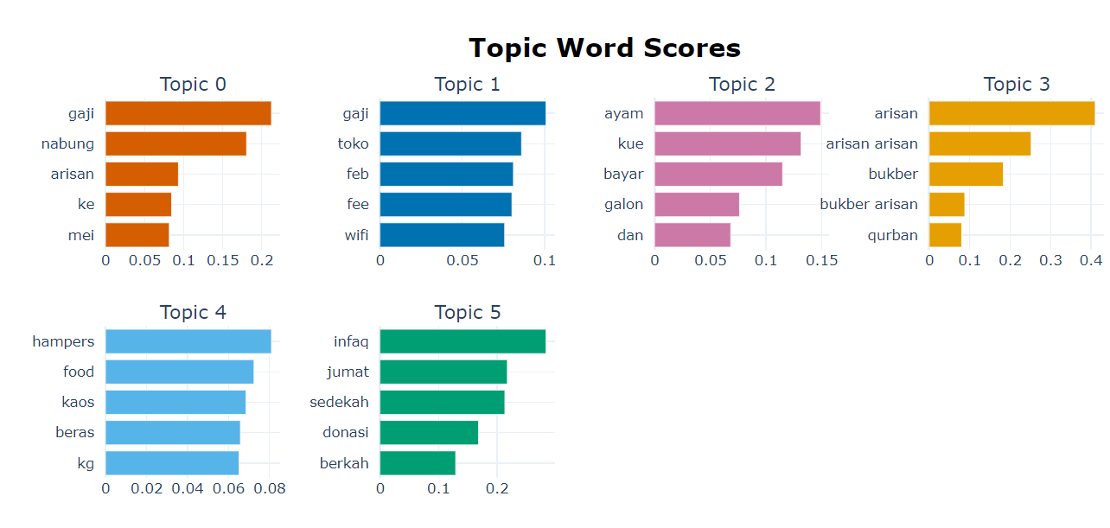
Topic Modeling
Topic modeling is a natural language processing technique that automatically identifies hidden topics or themes within a collection of documents, providing valuable insights for tasks such as content recommendation, information retrieval, and document categorization

Slide 24
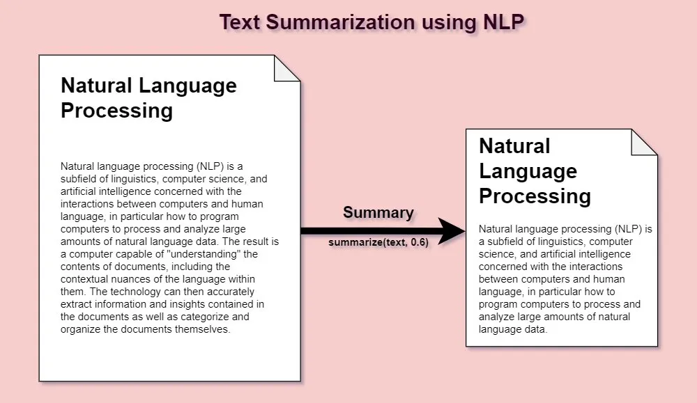
Text Summarization
Text summarization is the process of condensing a lengthy piece of text into a shorter, coherent version while preserving its most important information, making it invaluable for quickly extracting key insights from large documents, news articles, or research papers.

Slide 25
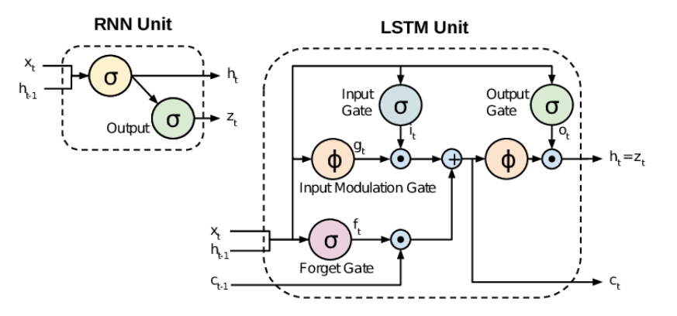
Deep Learning as Text Representation
Deep learning techniques, such as Long Short-Term Memory (LSTM) and Recurrent Neural Networks (RNN), are employed to create sophisticated text representations that can capture sequential dependencies and contextual nuances within language, enabling applications like machine translation and sentiment analysis to excel in understanding and generating human language

Slide 26
Terima kasih

